Slide 1
Shafts
Shafts: A rotating Member.
Usually has circular cross-section (solid or hollow)
Transmits power and rotational motion
Houses other components
Components: Gears, Pulleys, Flywheels, Clutches – are mounted on
shafts. Transmit power
Attachment: via Press-fit, Tapered fits, keys, pins, set-screws, splines –
for attaching machine elements to shafts
Mounted on: Bearings (rolling contact, journal bearings)
Couplings: Transmit power from driver shaft (motor) to driven machine
(gear box, wheel)

Slide 2
Shaft Design For Stress
Look for critical stress locations – Compare stresses at various locations
Most of the times shafts are under combined loading – compute alternating and mid range components of von-Mises stress
If axial stress is significant use Equations (6.55) and (6.56) from book
For fatigue use modified Goodman criterion
Always check for static yielding

Slide 3

Shaft Design For Stress
Stress Concentration – Shafts have steps, grooves, shoulder relief etc.,
for mounting gears, bearings, …
Challenge – Shaft diameter is not known apriori
Way out:
(Can start with the worst case scenario)
Also for keyways: Table 7-1 for static stress concentration factors
(select as starting values – 1st iteration)
Shaft Deflection: Table 7-2 for maximum permissible deflection and slope
Complete geometry of the shaft must be worked out for analysis
Also check for failure of keys, pins,
For key, pin sizes: Tables 7-5, 7-6, 7-7, 7-8

Slide 4
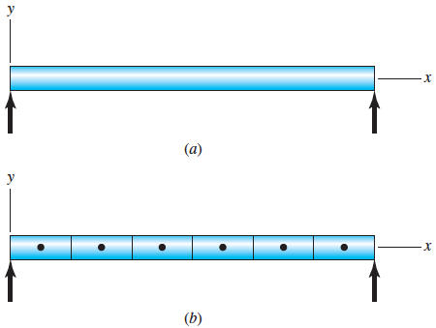
Shaft Vibration – Critical Speed
When the shaft is of uniform diameter.
For stepped shaft (segments of uniform diameter).

Slide 5
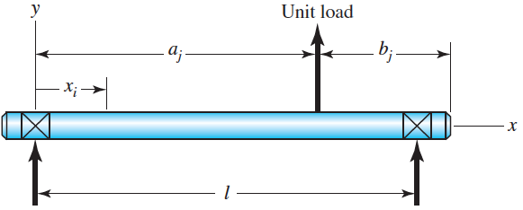
Influence Coefficient
Forces act due to mounting of machine elements (gears, pulleys, etc.)
For loads at multiple location – obtain influence coefficient matrix
 |  | Load location
 |  | 1 | 2 | 3 | ... j
Deflection location | 1 | δ₁₁ | δ₁₂ | δ₁₃ | δ_{1j}
 | 2 | δ₂₁ | δ₂₂ | δ₂₃ | δ_{2j}
 | 3 | δ₃₁ | δ₃₂ | δ₃₃ | δ_{3j}
 | i | δ_{ι1} | δ_{ι2} | δ_{ι3} | δ_{ιj}
Also – From Reciprocity Theorem
δ_{ij} = δ_{ji} (symmetric)

Slide 6
Influence Coefficient
Displacement at locations due to forces of magnitude F_{j}
This is an eigenvalue problem !!! The above has three eigenvalues
The CRITICAL SPEEDS

Slide 7
Influence Coefficient
From the characteristic equation can show
To include shaft mass:

Slide 8
Additional Topics
Miscellaneous shaft components: Section 7-7
Shaft limits, tolerances, and fits: Section 7-8

